Slide 1




Building Better Mobile Keyboard Suggestions with LLMs
Deutscher Akademischer Austauschdienst
German Academic Exchange Service
Riley Fiske
Advised By: Florian Bemmann, Prof. Mayer, Daniel Buschek

Slide 2
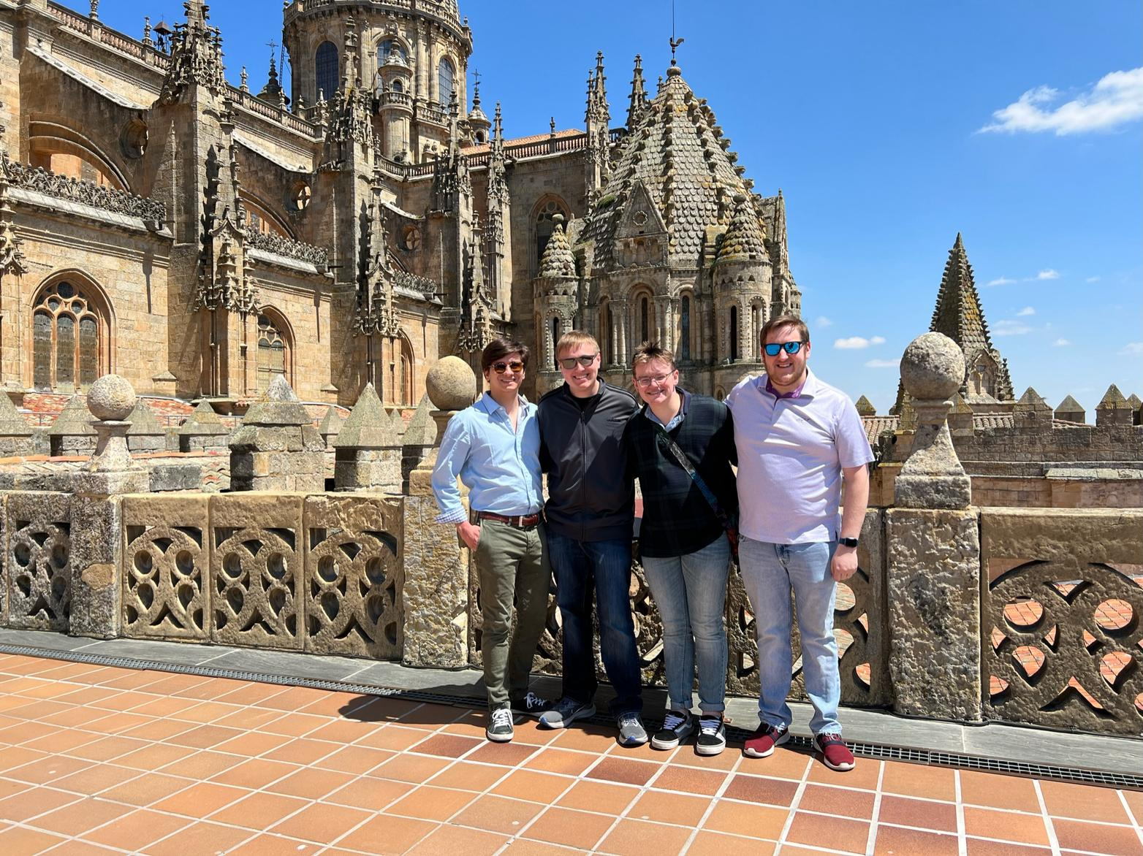
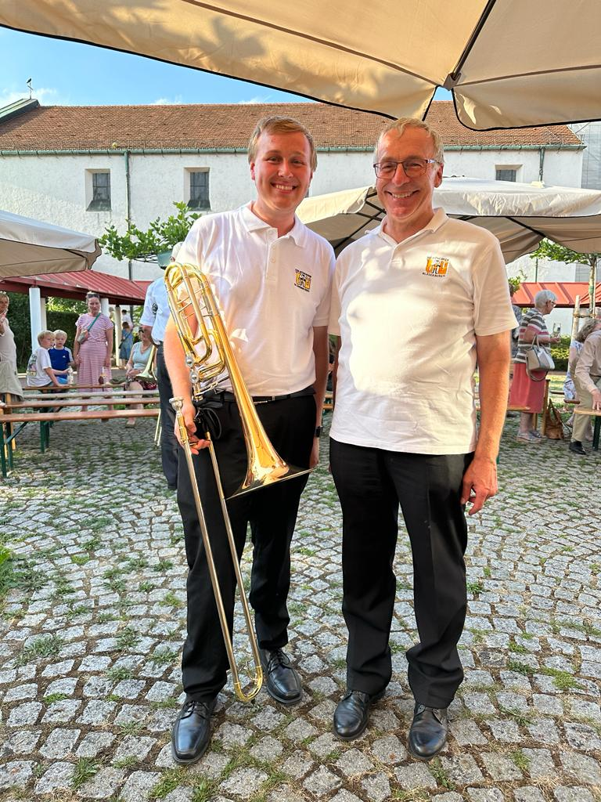
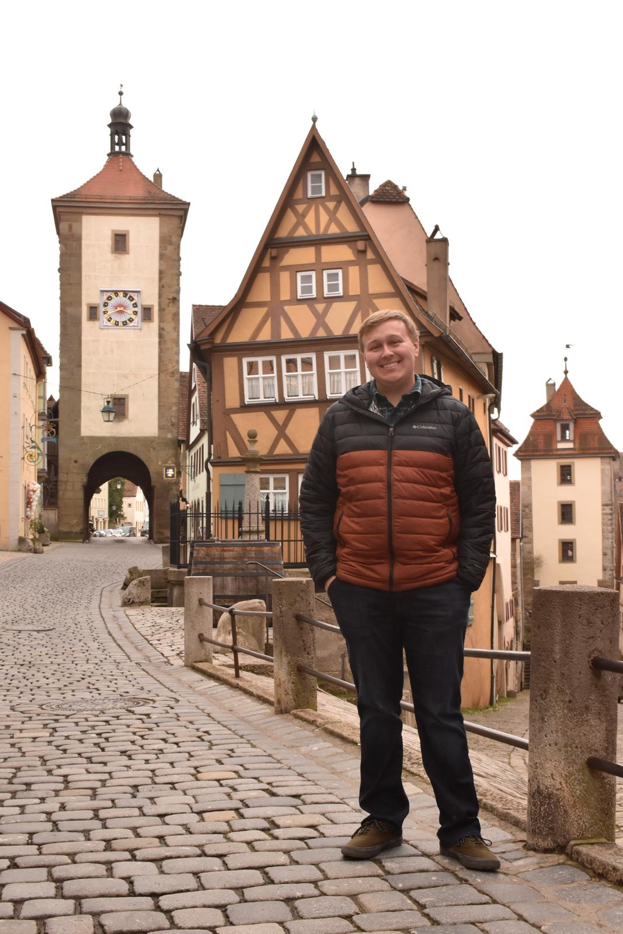

About Me
Senior – Mathematics, Computer Science, Data Science, German
Music – The Concordia Band, The Concordia Orchestra, Jazz Ensemble I
Passions: Travel, Reading, Music, Languages

Slide 3
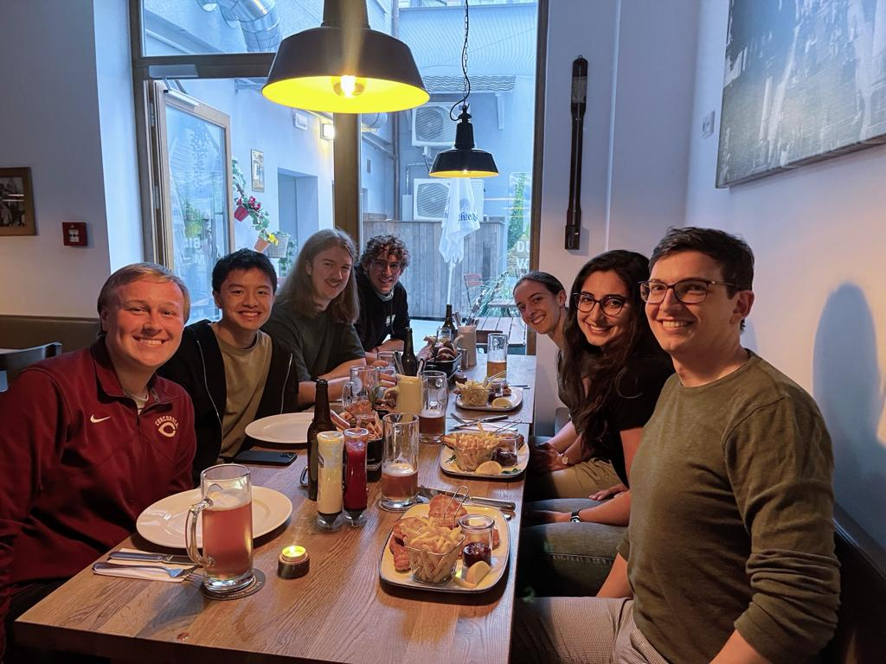
Internship Background
May 15th - August 9th, 2023
Munich, Bavaria, Germany
DAAD RISE Germany
Ludwig-Maximilians-Universität München
Institut für Informatik – Human Computer Interaction

Slide 4

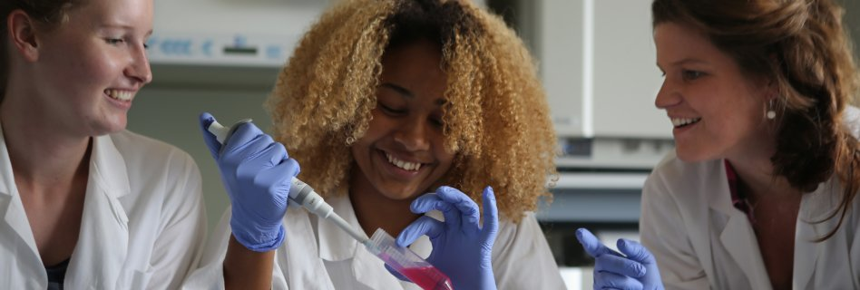
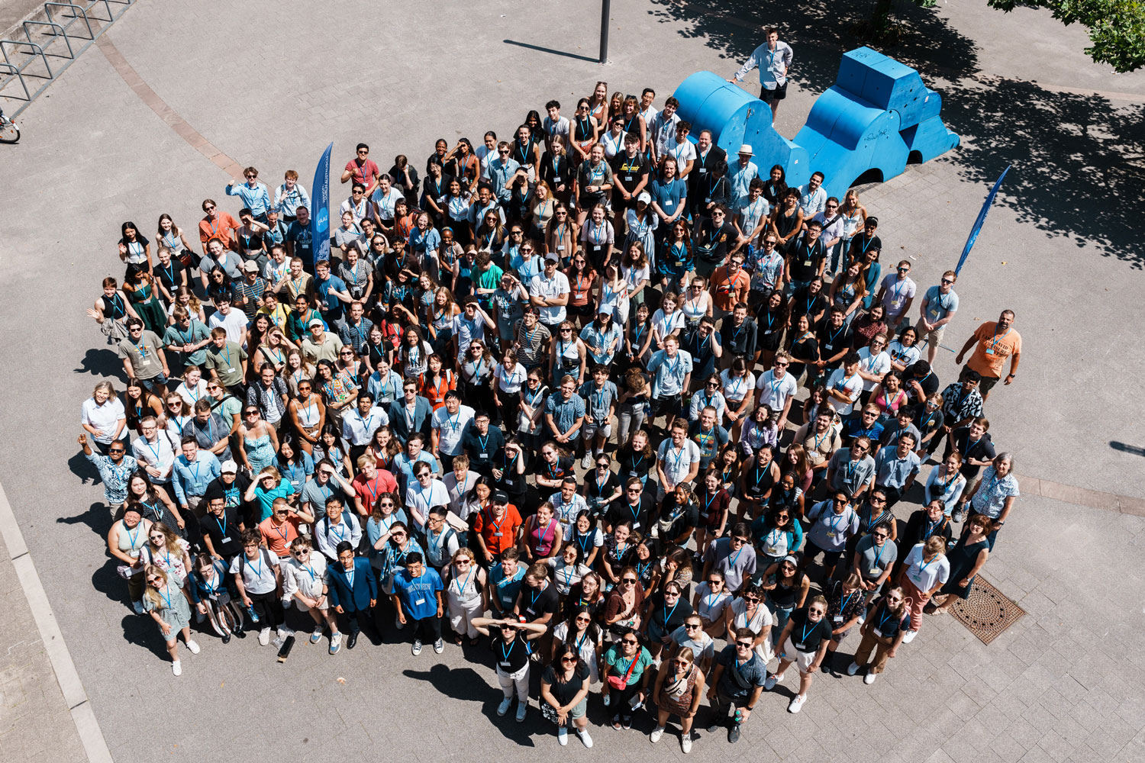
DAAD RISE Germany
Deutscher Akademischer Austauschdienst (DAAD)
Research Internships in Science and Engineering (RISE)
Summer Internships in Biology, Chemistry, Physics, Earth Sciences, Computer Sciences, Mathematics, & Engineering in Germany
Scholarship paid by the DAAD, funding by the German Government
No German Languages Skills Required
However, they’re highly helpful for navigating daily life and look great on an application!

Slide 5
Mobile Keyboard Status Quo

Slide 6
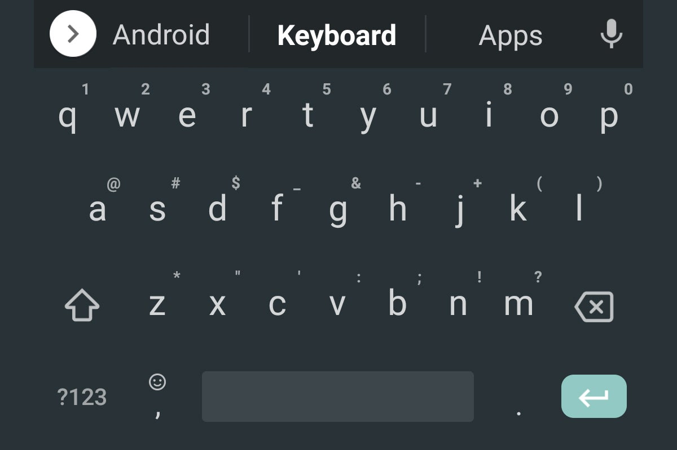
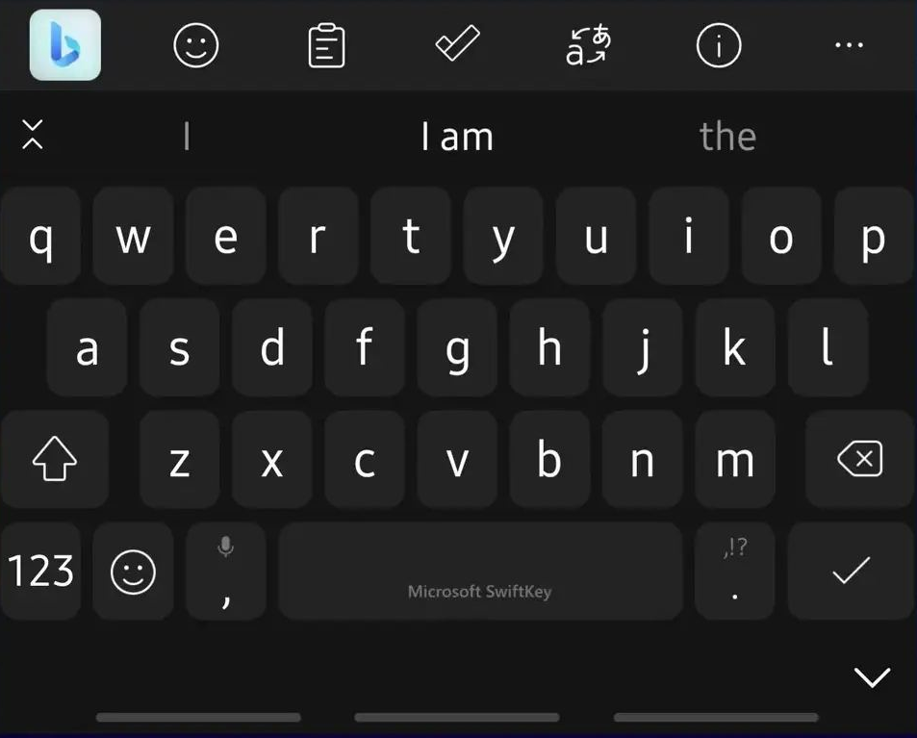
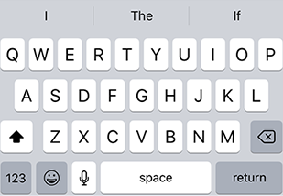
Traditional Mobile Keyboards
Android vs. iOS
Features:
Three Suggestion Words on Top Bar
Swipe Gestures
Third-Party Keyboard Features (Emoji, GIF, Clipboards, Translation, etc.)

Slide 7

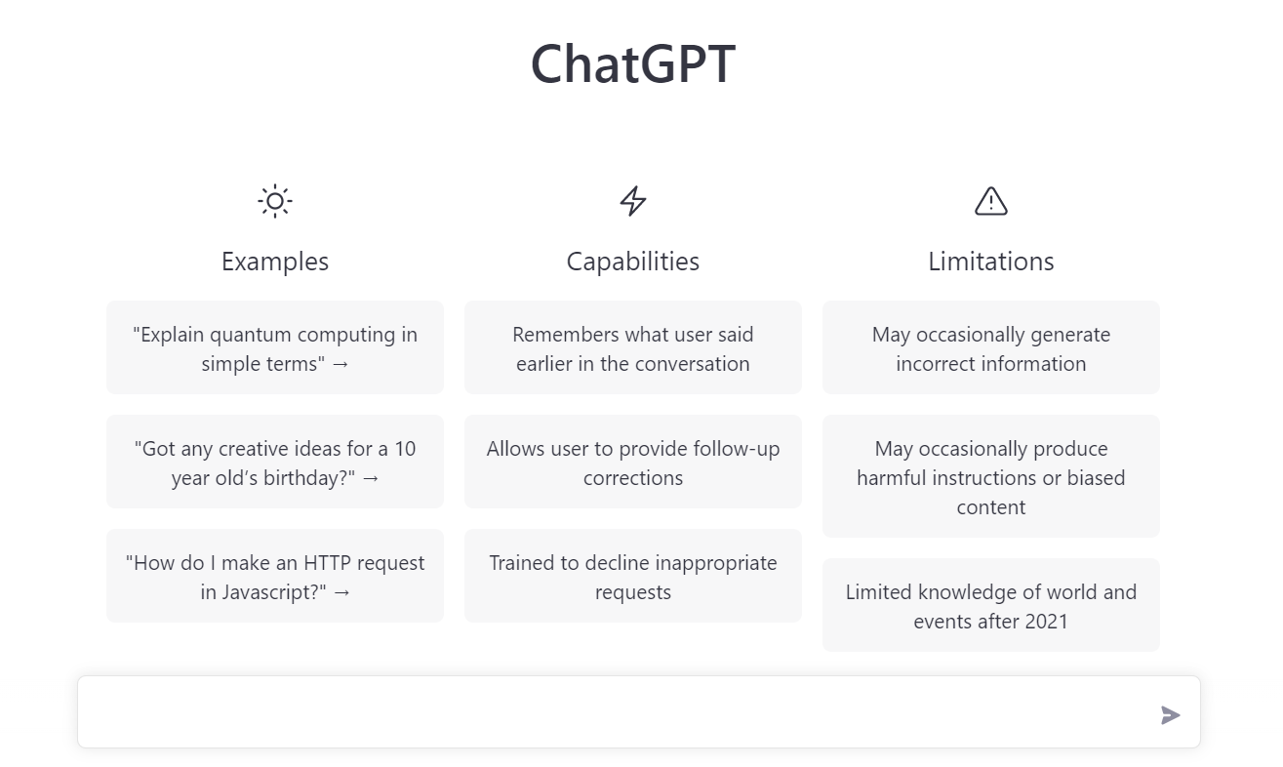

Large Language Models (LLMs) and Chat-GPT
30 November 2022
Chat-GPT launched and changed everything
Similar Models in industry previously
Now in the hands of consumers for no cost
Uses:
Creative Text Generation
Formal Text Drafting/ Proofreading
Code Generation
Image Generation
Task Automation
Analysis

Slide 8
Traditional Keyboards + Artificial Intelligence

Slide 9
Preliminary Work

Slide 10
Project Motivation
Previous Research in Mobile Keyboards by Florian and Daniel
Research-IME, LanguageLogger
Stagnant/Outdated Suggested Words Bar
It can be improved
Emergence of Easy-to-Use Text Generation Tools
Chat-GPT
Utility of LLM Mobile Keyboard
On-the-Go Quicker Messaging (less gestures, safer)
Minimize Keystrokes or device interaction time
Determine What Modules are Most Favored by Users

Slide 11
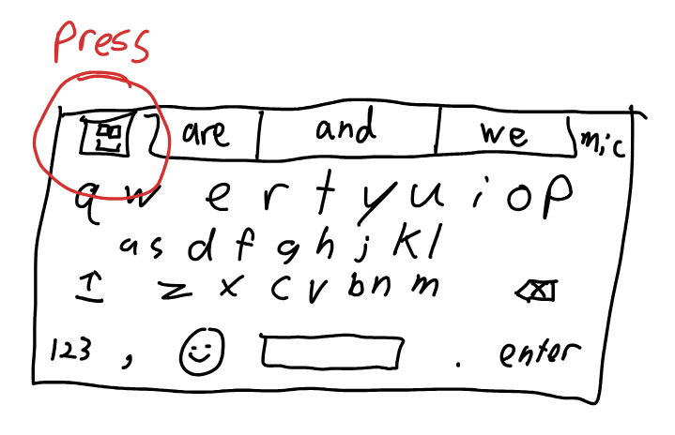
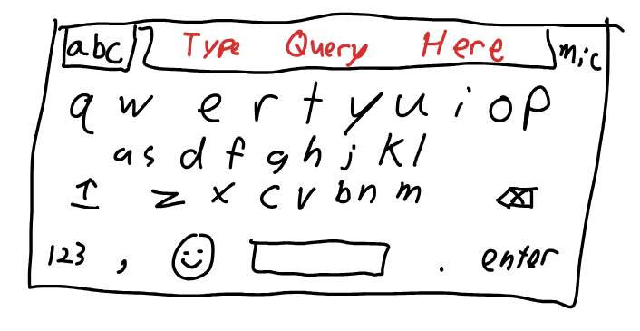
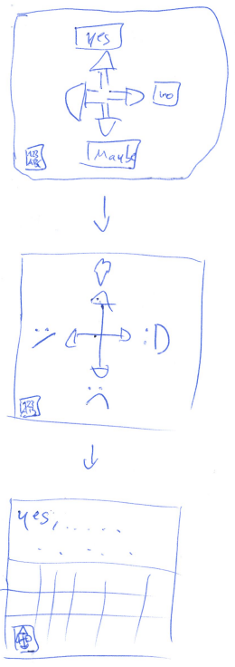
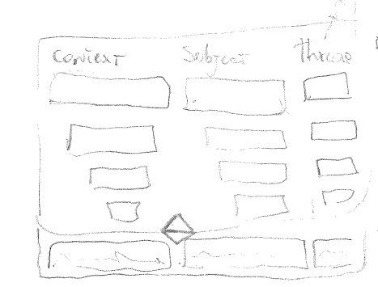
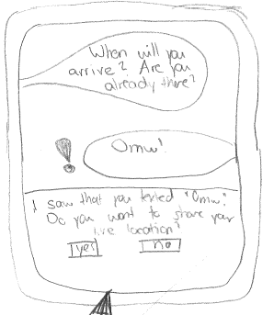
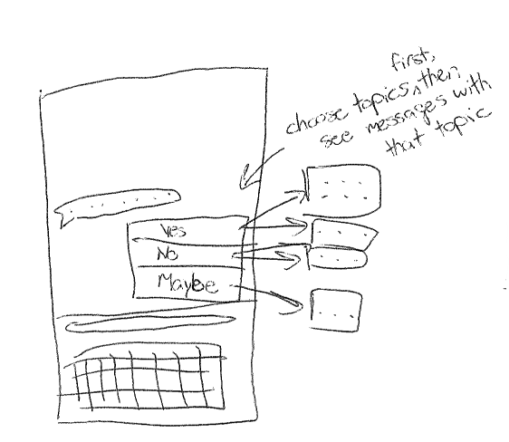
Design Sketches Focus Group

Slide 12
Design Sketches Analysis
Always leave option of traditional keyboard
Turning mechanical problem (typing) into cognitive problem (selecting options)
Specify Context for Generating Suggestions
Last X messages, custom select previous messages
Specify Keywords for Generating Suggestions
Specify Tone of Message with Color/Emoji

Slide 13
Prototype Designing

Slide 14
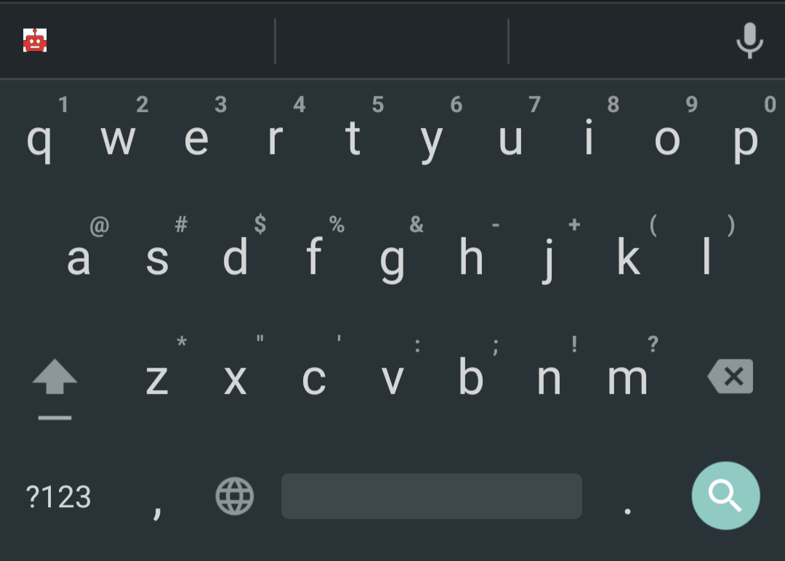
Traditional Keyboard Screen
Functions as a Normal Keyboard

Slide 15
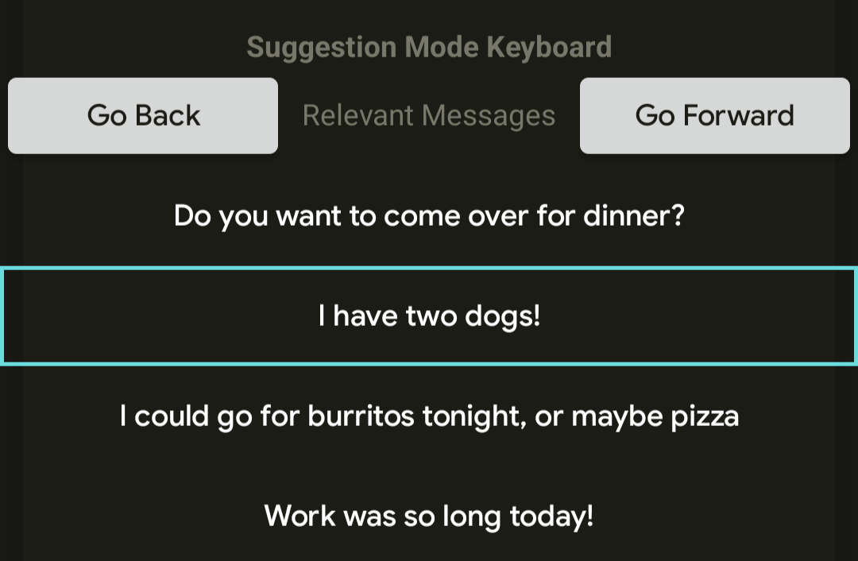
Relevant Messages Screen
Extracts previous 4 messages
Select 0-4 messages to include in suggestion context

Slide 16
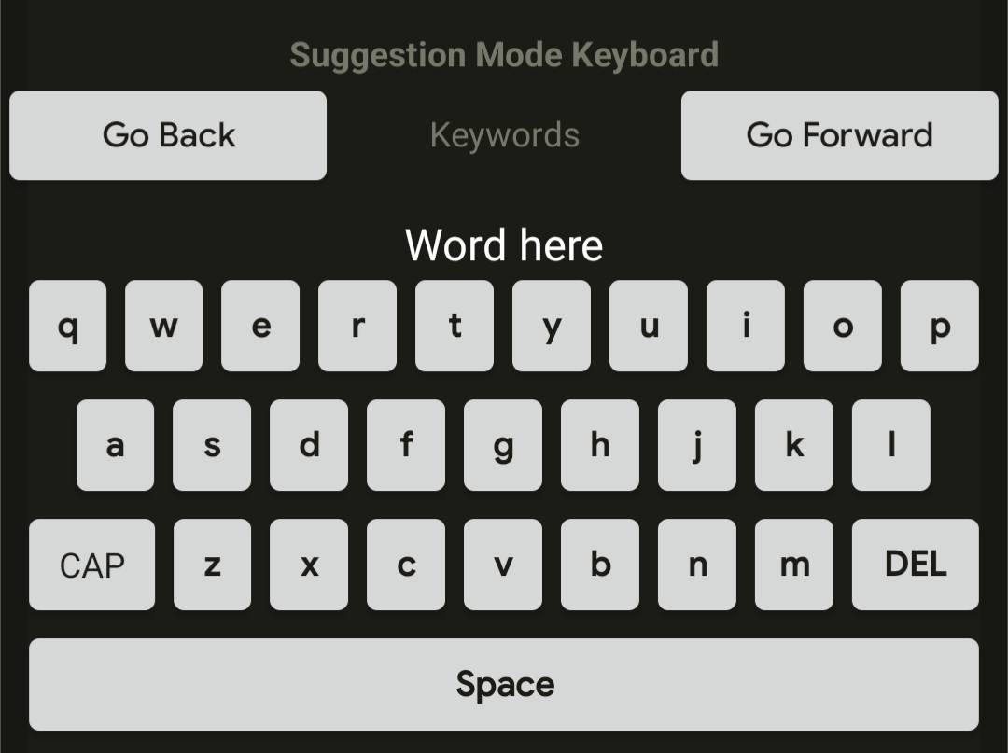
Keywords Screen
Enter keywords to summarize the reply

Slide 17
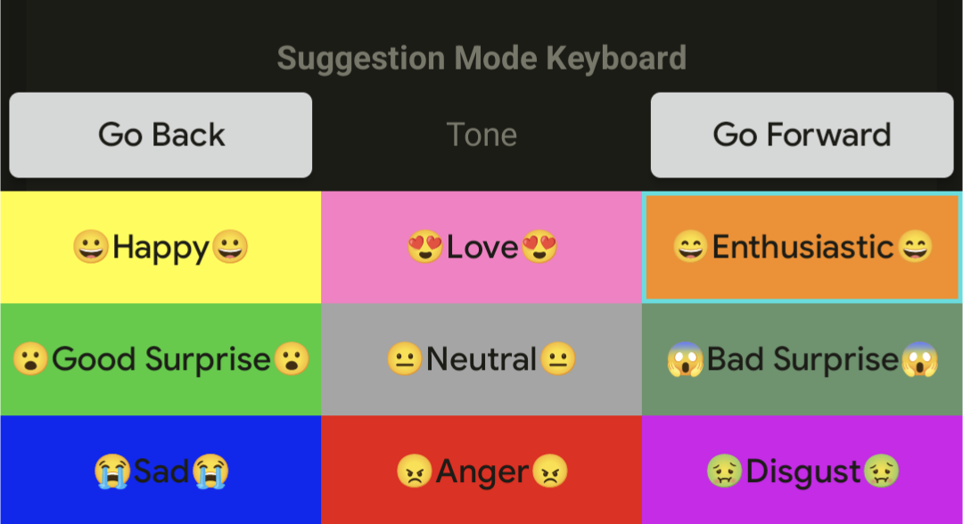
Tone Screen
Select tone of suggested messages
Maximum 1 Tone

Slide 18
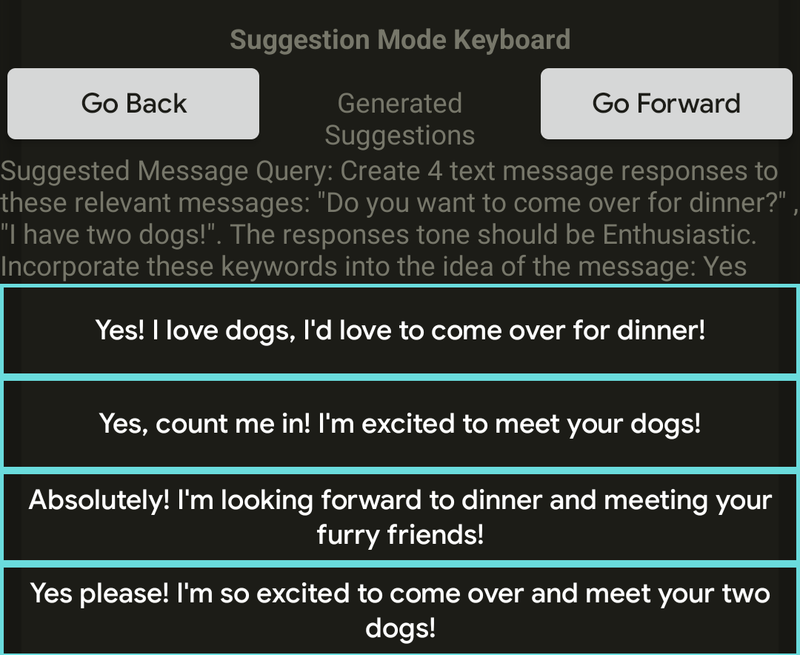
Suggestion-Preview Screen
Displays 4 Suggested Response Messages
Message Query shown here for testing
Select 1 message, which will populate in the compose line

Slide 19
Prototype Analysis

Slide 20
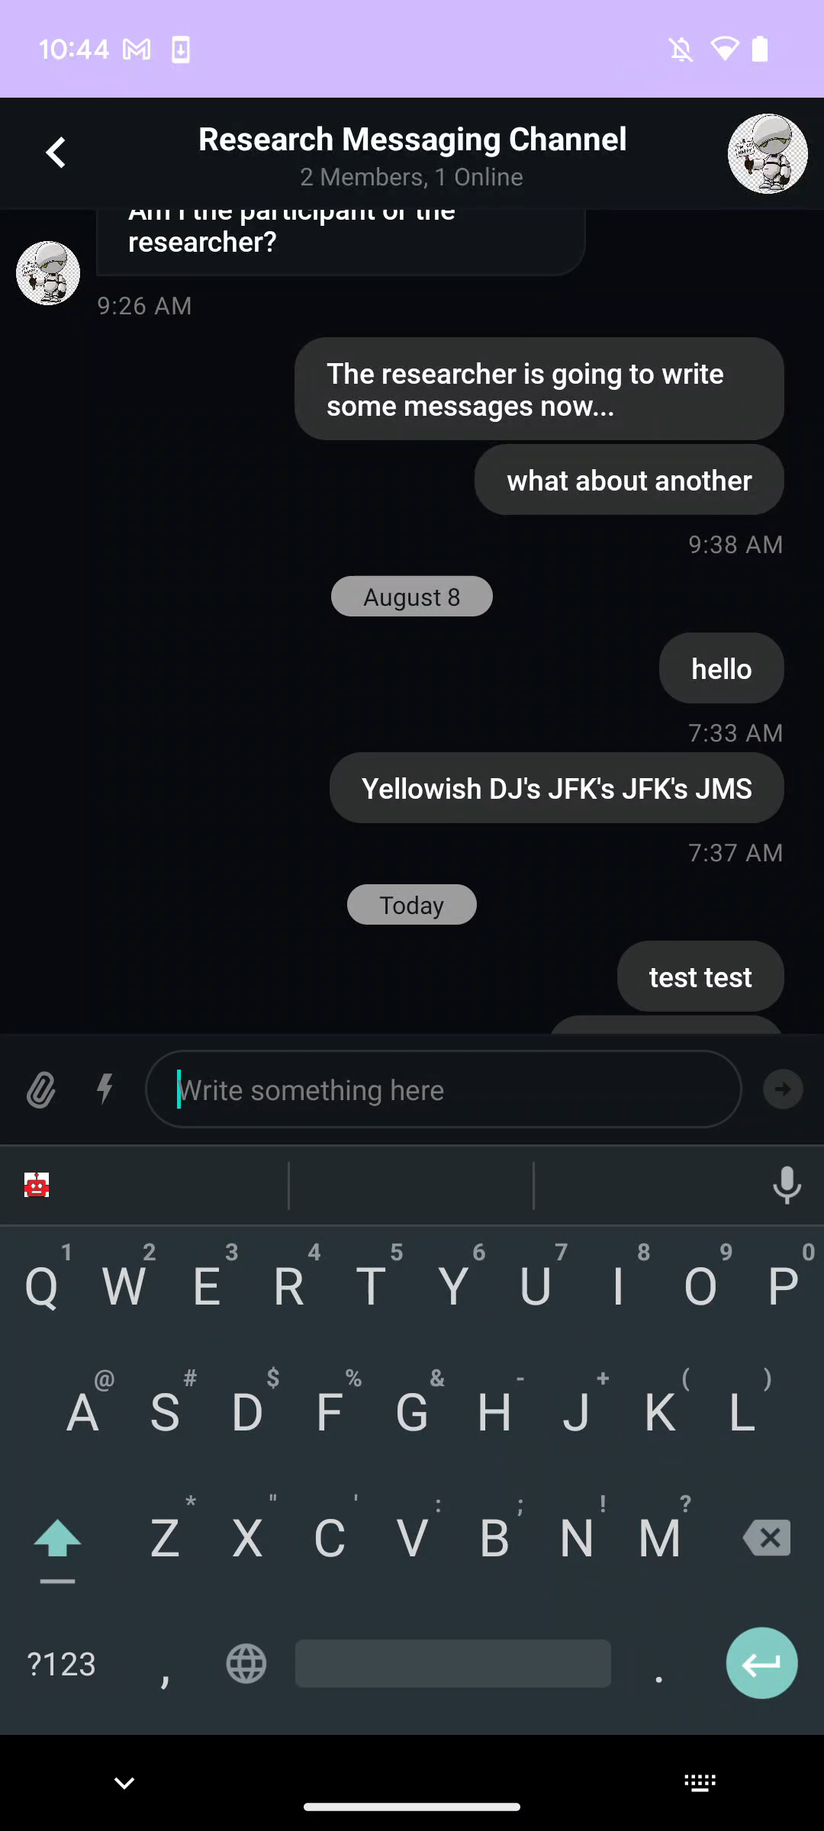
Prototype Testing Focus Group
Tone slightly overrode Relevant Messages
If Tone and Relevant Message Conflict
Chat-GPT can fill in its own context sometimes
Change Suggestion Mode Button Placement
Add Frequently Used Keywords?
Requires a User System

Slide 21



Work Since Summer
Repaired Chat-GPT API Plugin
New GPT
Populate Message in Compose Line
Clear User Input between Message Generations
Preliminary User Study Designing
Project Write-Up on Overleaf

Slide 22
Demo

Slide 23

Future Work
Fix Database Extraction Pipeline for Relevant Messages
Move Suggestion Mode Button
Spacebar
Bottom of Keyboard
Finish Study Design
Conduct Study
Finish Research Paper and Publish

Slide 24


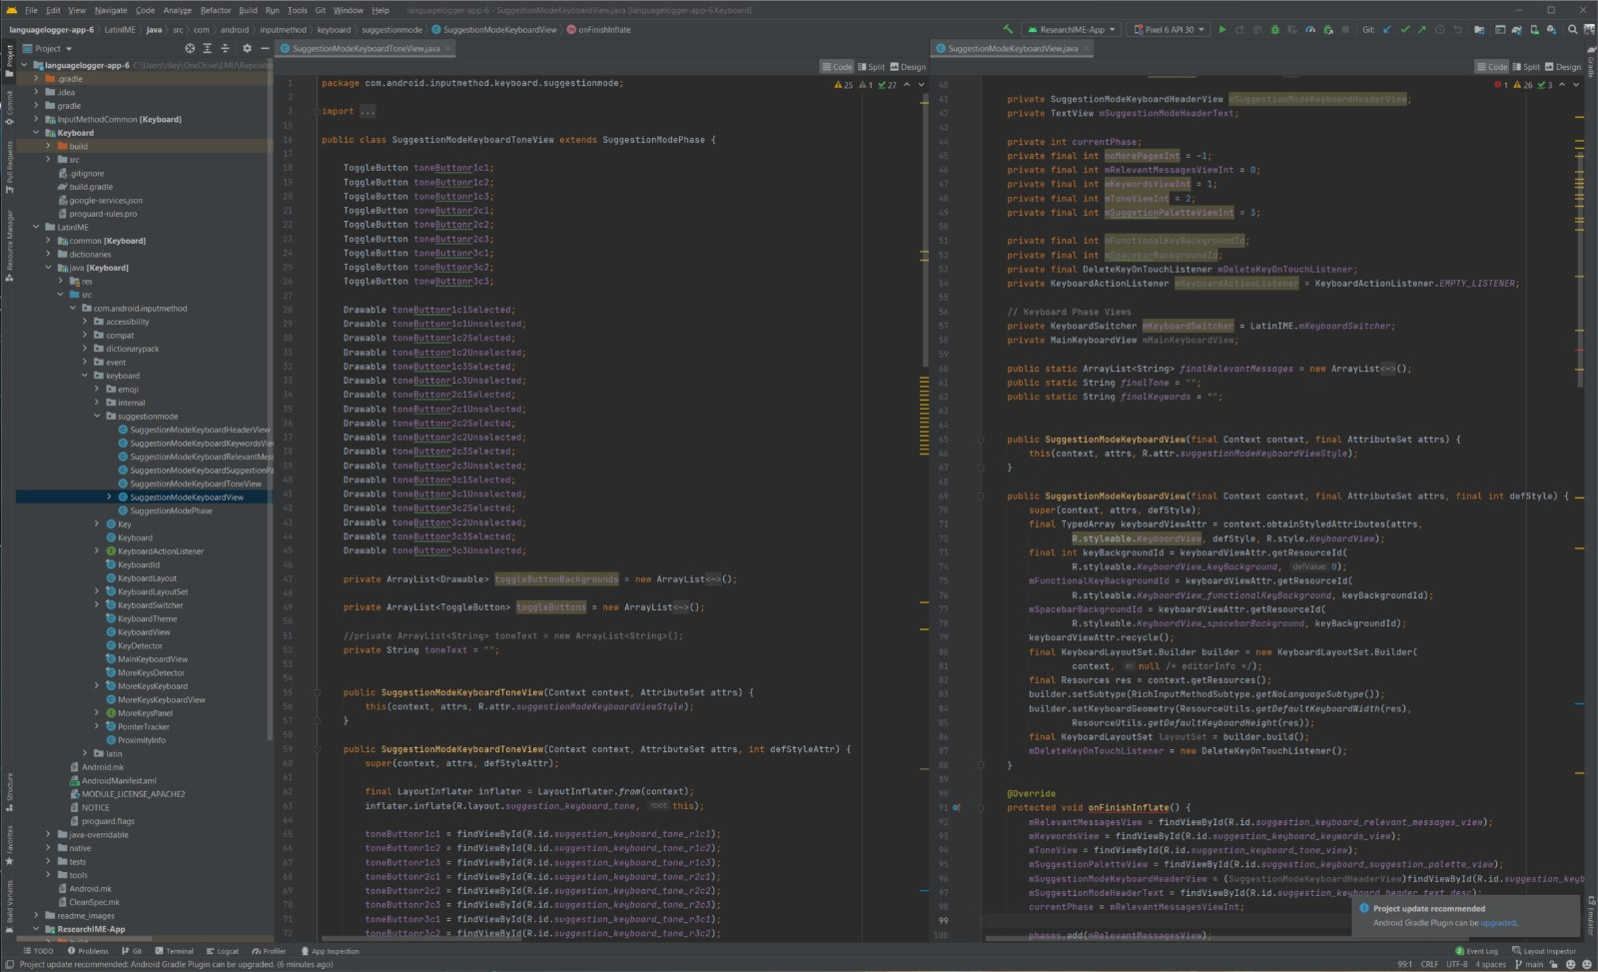
Takeaways – Technical
Work with Android and Java in an existing Project
Research-IME
Program Interacting with other Programs
Android
Firebase
Pipedream
Chat-GPT API
Research Process in Programming

Slide 25
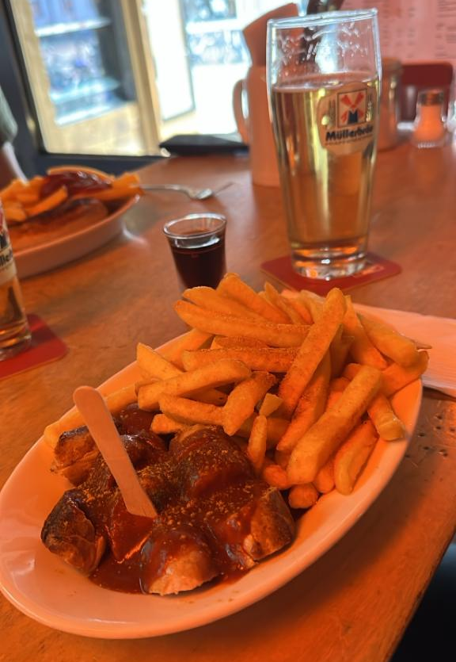
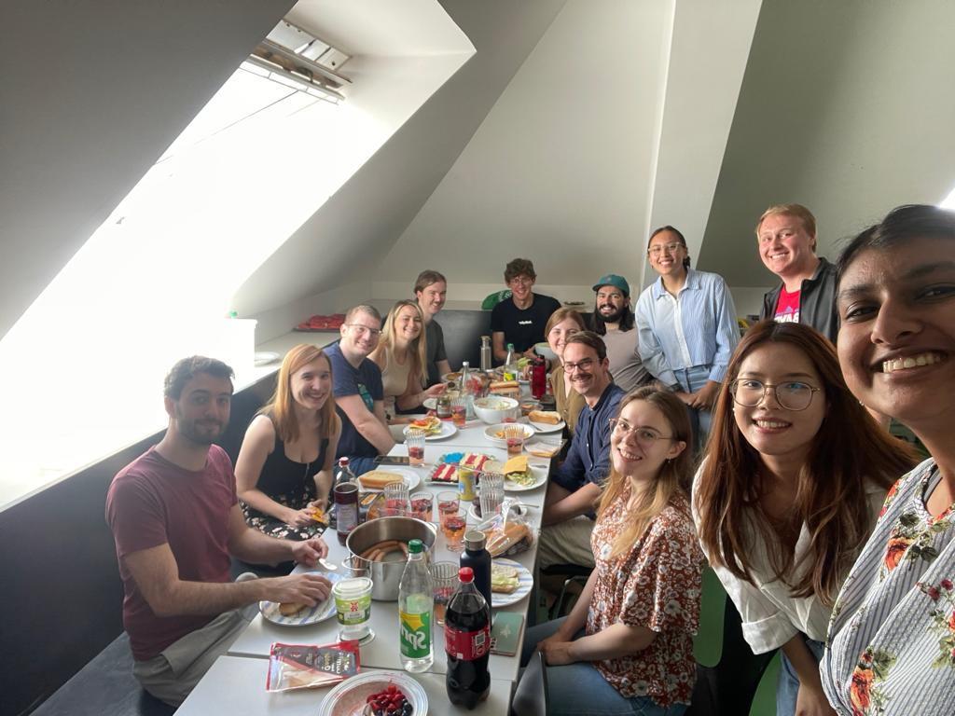
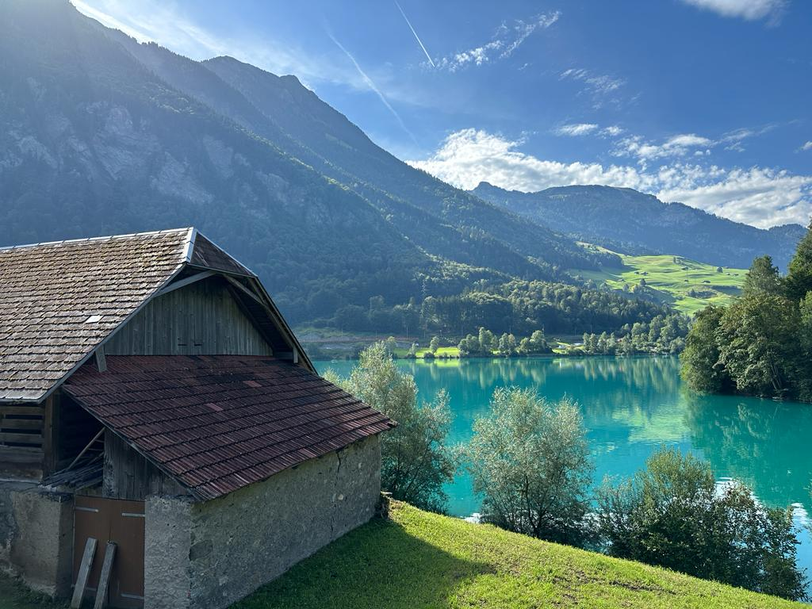
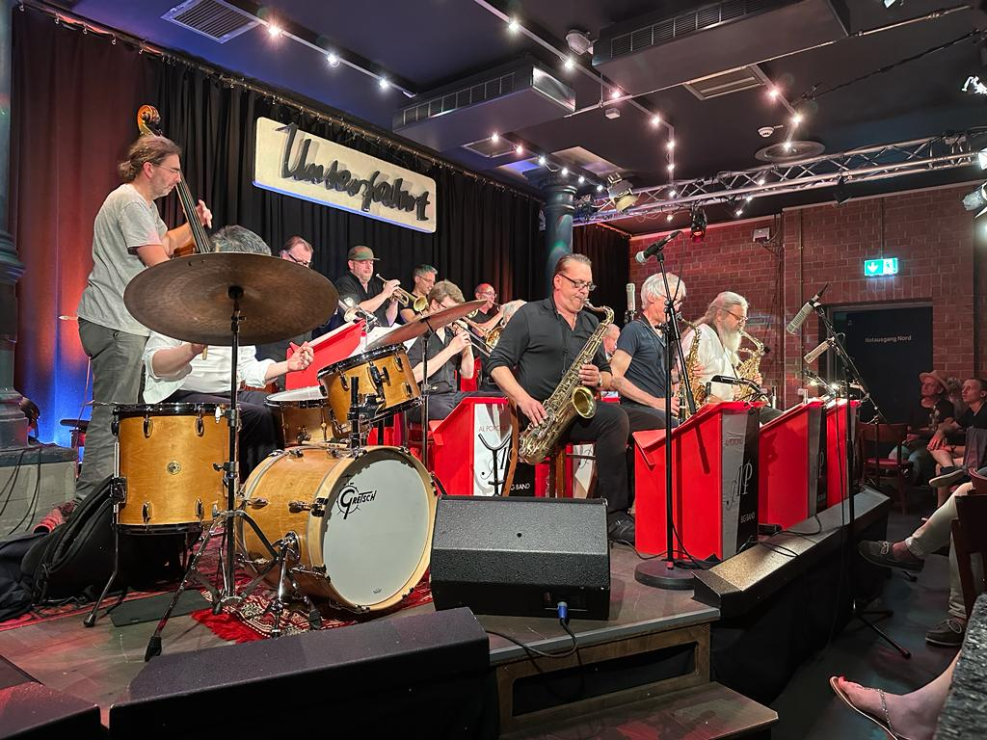
Takeaways – Cultural
German Culture
Linguistics
Public Transit
Physical Cash
Bavarian Culture
Food and Drink
Slang
Nature/Hiking
Festivals
Essen und Getränken
Mahlzeit!
Wandern
Feierabend!

Slide 26
Questions?
Contact
Riley Fiske
rfiske1@cord.edu

